Slide 1


WEB BASED PROJECT BIDDING SYSTEM FOR AN IT ORGANIZATION Presented by Ms. A. Fameeha Zeenath (Reg No:820323622019) Final Year-MCA Under the Supervision of Dr. A. Suganthi MCA.,M.Phil.,Ph.D., Assistant Professor Department of Computer Applications A.V.C. College of Engineering, Mannampandal, Mayiladuthurai-609305

Slide 2
PROBLEM STATEMENT
Clients struggle to locate highly specialized or niche-skilled freelancers due to limited talent pools and inadequate filtering options.
Many freelance platforms do not authenticate developer skills, leading to issues with unreliable or unqualified hires.
The absence of an efficient project-matching system results in prolonged hiring times, delaying project execution.
They are self-employed, meaning they are considered to work for themselves. There isn't a set amount of hours you must work to be considered a freelancer.

Slide 3
PROBLEM STATEMENT
Clients often face difficulties in determining fair pricing for projects due to inconsistent bidding structures and lack of market benchmarks.
Without secure payment gateways and escrow systems, both freelancers and clients risk non-payment or fraud.
Lack of monitoring mechanisms leads to freelancers missing deadlines, affecting project timelines.
Freelancers typically require signed contracts for the job to be done. They'll agree to a predetermined fee based on the time, skill, and effort required to complete the task.

Slide 4
PROBLEM STATEMENT
Companies hiring multiple freelancers for a project struggle with coordination, tracking progress, and assigning tasks.
Existing platforms focus on short-term projects, lacking features for businesses to build long-term partnerships with freelancers.
Clients have no way to ensure that freelancers deliver work that meets quality standards or industry best practices.
They are self-employed, meaning they are considered to work for themselves. There isn't a set amount of hours you must work to be considered a freelancer.

Slide 5
DISADVANTAGES OF EXISTING SYSTEM

Slide 6
Platforms offer generic solutions, making it hard to tailor features to specific user needs. Skill-matching algorithms may not accurately align freelancers with project requirements. Evaluating multiple proposals is cumbersome without advanced comparison tools.
Vulnerabilities in data security and privacy can expose sensitive information. Limited communication features may hinder effective project discussions. Difficulties in automating payments and managing contracts can cause transaction issues.
Basic analytics restrict insights into project performance and user engagement. Lack of effective mechanisms can leave conflicts unresolved. Excessive or poorly managed notifications can lead to missed updates or user fatigue.
Outdated interfaces and performance problems can detract from overall user satisfaction.

Slide 7
ADVANTAGES OF PROPOSED SYSTEM

Slide 8
The platform offers extensive customization options for user profiles, allowing freelancers and clients to tailor their information and project requirements to specific needs. Users can create highly specific project postings with detailed criteria, enhancing the match between projects and freelancers.
Utilizes cutting-edge algorithms to accurately match freelancers' skills with project requirements, improving the efficiency and relevance of job matches. Employs AI to recommend the best freelancers or projects based on historical data and user preferences.
Features tools that automatically evaluate and rank proposals based on predefined criteria, streamlining the selection process. Provides a user-friendly interface for managing and reviewing multiple proposals, facilitating better decision-making.
Implements state-of-the-art encryption to safeguard sensitive user data and transactions. Adds an additional layer of security with multi-factor authentication for user accounts.

Slide 9
PROPOSED PLATFORM

Slide 10
PROPOSED PLATFORM
SOFTWARE REQUIREMENTS
Server Side : Python
IDE : Flask
Front End : Html, CSS, Javascript
Back end : MySQL 8
Server : Wampserver 2i
OS : Windows 10 64 –bit

Slide 11
HARDWARE REQUIREMENTS
Processors : Intel® Core™ i5 processor
RAM :16 GB of DRAM
Speed :2.1 GHZ
Disk space : 320 GB

Slide 12
MODULE IDENTIFICATION

Slide 13
MODULE IDENTIFICATION
Registration Module
1.1 Projects
1.2 Freelancer
1.3 Employer
2. Portfolio Module
2.1 Create Portfolio
2.2 Add Experience
2.3 Add Education & Certifications
2.4 Upload Work Samples
2.5 Upload / Delete Portfolio Info

Slide 14
MODULE IDENTIFICATION
3. Project Bidding Module
3.1 View Available Projects
3.2 Place a Bid
3.3 Manage Bids
3.4 Notification Alerts
4. Incentives & payment Module
4.1 View Earning
4.2 Link Payment Methods
4.3 Receive Payment
4.4 Track Incentives

Slide 15
MODULE IDENTIFICATION
5. Feedback & Review Module
5.1 Give Feedback to Freelancer
5.2 Receive Employee Feedback
5.3 View Past Review
6. Report Module
6.1 Project wise- Report
6.2 Freelancer wise- Report
6.3 Employee wise-report

Slide 16
MODULE DESCRIPTION

Slide 17
1. Registration Module
MODULE DESCRIPTION
1.1 Projects – Register new projects with detailed descriptions, specify project categories, required skills, and timelines. Set budget range and payment terms for each project. This feature allows employers to register new projects by entering comprehensive details such as the project title, description, required skills, category.
1.2 Freelancer – Sign up using email or social media, create a personalized profile with skills, Bio, and photo, set hourly rate, availability, and preferred work type. Freelancers can register through email or social media. During registration, they can create a professional profile including their personal details.
1.3 Employer – Register to post job listings and view freelancer profiles, manage multiple project postings from a single dashboard, communicate with freelancers and assign tasks. Employers can sign up to post project listings, manage ongoing and completed projects.

Slide 18
MODULE DESCRIPTION
2. Portfolio Module
2.1 Create Portfolio – Build a professional portfolio with personal details, areas of expertise, add a professional summary or tagline. Freelancers can create a complete portfolio by entering personal and professional information.
2.2 View Experience – Add previous job or freelance experiences with timeline, list achievement or milestones reached in each role. Enables users to enter their previous work history including job title, organization name
2.3 View Qualification – Enter academic qualifications with institution and year, upload Users can input academic qualifications degrees, and certifications obtained through online platforms or professional bodies.
2.4 Upload Work Samples – showcase work using images, documents, or links, categorize samples based on skill or industry. Freelancers can upload images, videos, Documents.
2.5 Upload / Delete Portfolio Info – Edit, update, or delete outdated portfolio items, maintain up-to-date information. Allows for real-time updates, letting freelancers keep their profile current Update

Slide 19
MODULE DESCRIPTION
3. Project Bidding Module
3.1 View Available Projects – View available projects posted by employers, view project details such as description, skills required, and employer profile. Freelancers can view available projects with complete details, including title, description, and timeline
3.2 Place a Bid- Place bids on suitable projects based on skills and interest, mention estimated cost, completion time, and strategy. Withdraw or edit bids before deadline.
3.3 Manage Bids – Manage submitted bids and update proposals, view the list of all submitted bids and their current status. Through the Manage Bids section, freelancers can monitor all their active, pending, accepted, or rejected bids
3.3 Notification Alerts – Receive real time alerts and notifications, receive notifications for bid acceptance Enable or disable email and in- app notifications. The Notification Alert system sends real-time updates about bid status changes.

Slide 20
MODULE DESCRIPTION
4. Payment & Incentives Module
4.1 View Earning – View total earning from all completed projects, access detailed transaction history with dates and project names, generate earnings report for custom date ranges. The View Earnings feature allows freelancers to see a detailed breakdown of their income from completed projects.
4.2 Link Payment Methods – Add multiple payment options, set a default method for receiving payments, and update payment credentials. Through the Link Payment Methods functionality, users can securely connect their preferred payment.
4.3 Receive Payment – Receive payment automatically after project completion, get status updates for pending or processed payments. The Receive Payment option ensures timely transfer of funds once a project is successfully completed.
4.4 Track Incentives – Track bonuses for early delivery or high quality work, view performance- based rewards from employers.

Slide 21
MODULE DESCRIPTION
5. Feedback & Review Module
5.1 Give Feedback to Freelancer – Provide feedback to freelancer after project completion. Employers can rate freelancers based on project performance. Through the Give Feedback to Freelancer feature, employers can rate and review freelancers based on criteria such as work quality, communication, timeliness, and professionalism. This helps future employers make informed decisions.
5.2 Receive Employee Feedback – Freelancers receives ratings from employers after project completion, View employer comments and suggestions for growth. Receive Employee Feedback option enables freelancers to view the ratings and comments provided by clients, which can be used to improve future performance.
5.3 View Past Review – Access full history of feedback and reviews received and given. Filter reviews by date, project, or rating. Export feedback reports for personal record or profile use

Slide 22
MODULE DESCRIPTION
6. Report Module
6.1 Project wise - report – Submit reports related to specific project issues, include project ID, timeline, milestones and related documents. Allow status tracking of submitted reports, enable admins to take necessary actions.
6.2 Freelancer wise -report – File reports about freelancer behavior or performance, Attach communication logs or task evidence. Freelancer-wise Report gives a comprehensive overview of each freelancer’s activities.
6.3 Employee wise - report– Submit complaints or feedback about employers, Freelancers can provide supporting details for better assessments, platform admins handle the report to ensure air resolutions. the Employee-wise Report displays the employer’s hiring history, posted projects, feedback given, and payment records

Slide 23
SYSTEM ANALYSIS AND DESIGN

Slide 24
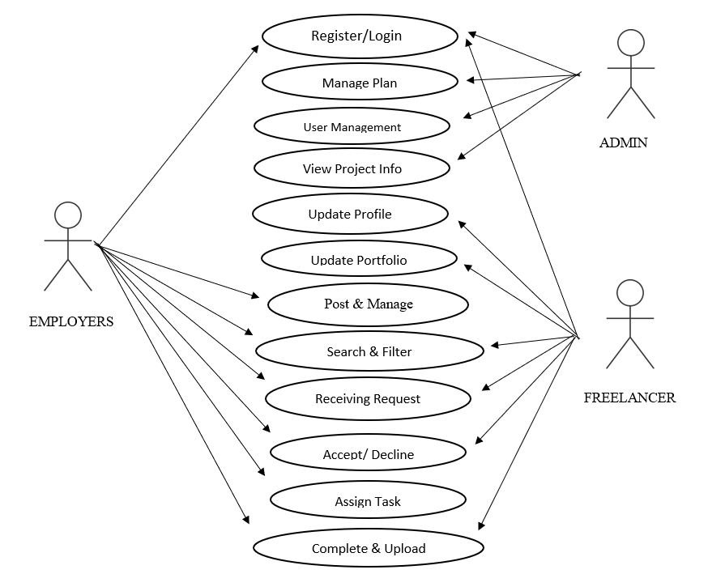
USE CASE DIAGRAM

Slide 25
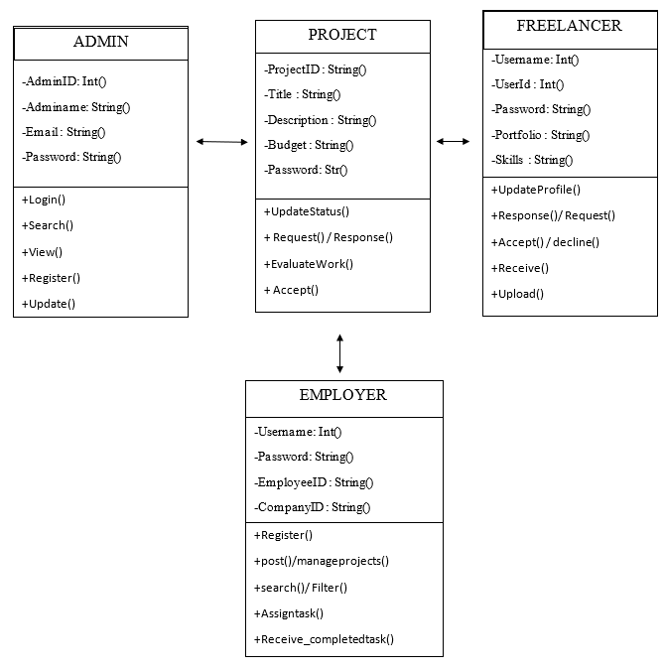
CLASS DIAGRAM

Slide 26
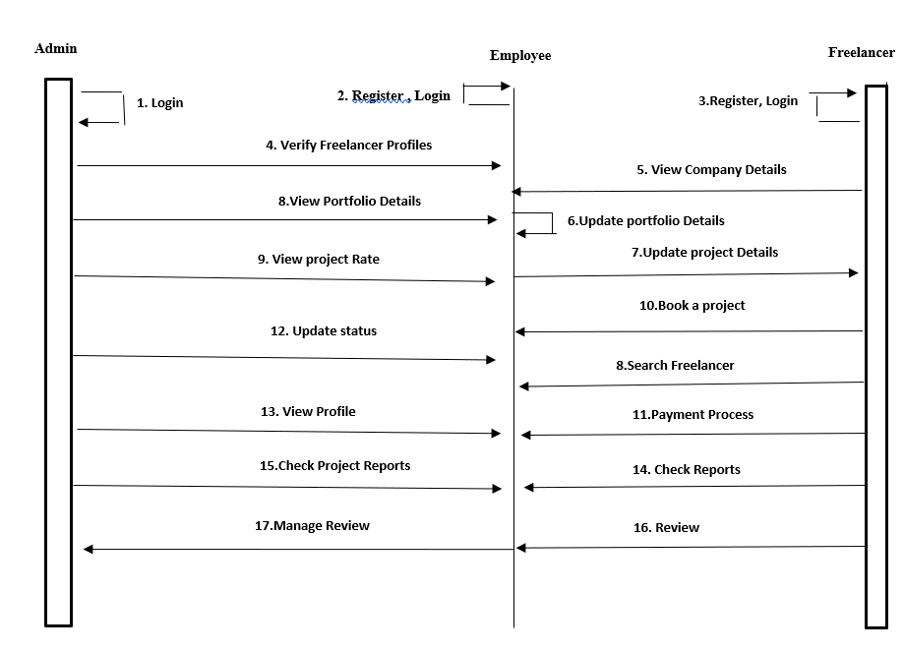
SEQUENCE DIAGRAM

Slide 27
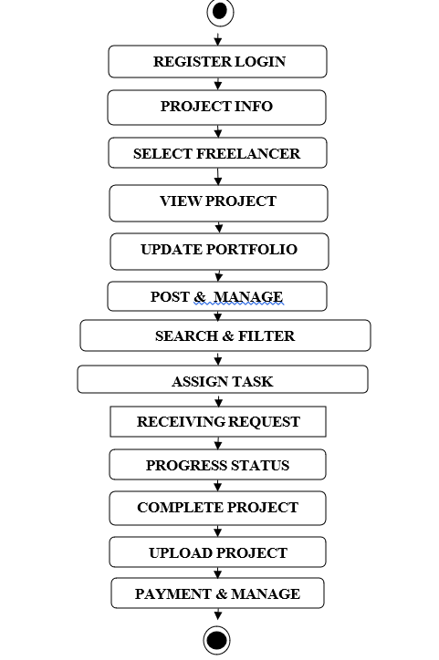
ACTIVITY DIAGRAM

Slide 28
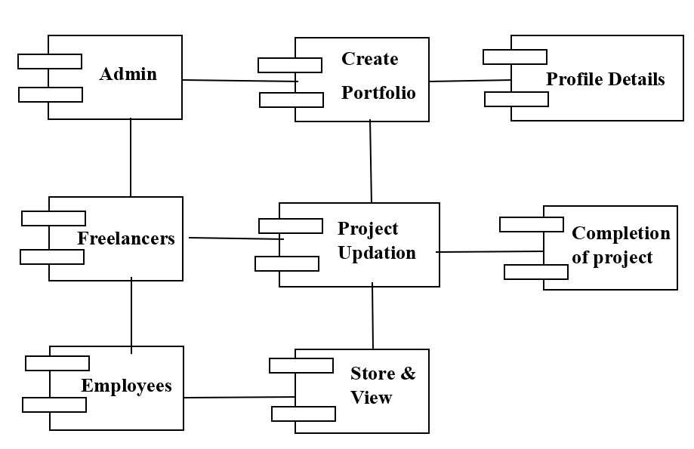
COMPONENT DIAGRAM

Slide 29
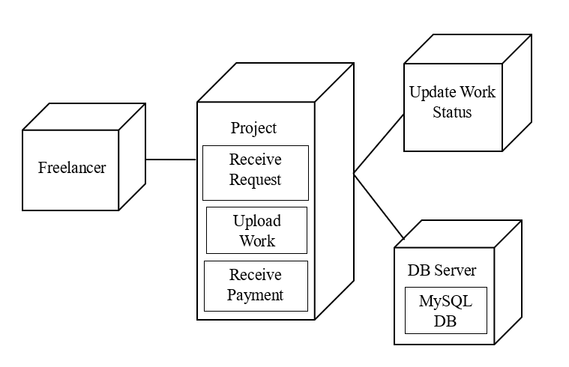
DEPLOYMENT DIAGRAM

Slide 30
DATABASE DESIGN

Slide 31
DATABASE DESIGN
Table Name: Employer Table
Description: This table stores Employer details
Field | Data Type | Constraints | Description
Employer_ID | INT(15) | PRIMARY KEY | Unique employer ID
Company details | VARCHAR(100) | Not Null | Company Background
Location | VARCHAR(50) | Not Null | Location of Employer
Project _Samples | BLOB | Null | Uploaded project Samples
Created_Date | DATE | Not Null | Portfolio Creation Date
Last_Updated | DATE | Null | Last Updated Date

Slide 32
DATABASE DESIGN
Table Name: Freelancer Table
Description: This table stores details of freelancers
Field | Data Type | Constraints | Description
Freelancer_ID | INT(15) | PRIMARY KEY, UNIQUE | Unique ID for the Freelancer
Full_Name | VARCHAR(50) | Not Null | Full Name of the User
Email | VARCHAR(50) | Not Null, UNIQUE | Unique Email Address
Phone | INT(15) | Not Null | Contact Number
Company_Name | VARCHAR(60) | Not Null | Company Name
Location | VARCHAR(50) | NOT NUL | Current Location
Profile_Image | BLOB | Null | Uploaded Profile Photo
Registration_Date | DATE | Not Null | Date of Account Creation

Slide 33
DATABASE DESIGN
Table Name: Login Table
Description: This table stores login credentials for admin users
Field | Data Type | Constraints | Description
User_ID | VARCHAR(20) | FOREIGN KEY references from (freelancer (Freelancer_ID) Employer ( Employer_ID), UNIQUE | Unique ID for Freelancer and Employer
Username | VARCHAR(30) | Not Null, UNIQUE | Unique Username
Password | VARCHAR(100) | Not Null | Encrypted Password
Email | VARCHAR(50) | Not Null | User Email
Last_Login | DATE | Null | Last Login Timestamp

Slide 34
DATABASE DESIGN
Table Name: Portfolio Table
Description: This table stores freelancer portfolio and experience details
Field | Data Type | Constraints | Description
Portfolio_ID | INT(15) | PRIMARY KEY | Unique Portfolio ID
Freelancer_ID | INT(15) | FOREIGN KEY references from Freelancer (Freelancer_ID) | Unique Freelancer ID
Experience | VARCHAR(100) | Not Null | Work Experience Details
Education | VARCHAR(100) | Not Null | Educational Background & Certifications
Work_Samples | BLOB | Null | Uploaded Work Samples
Created_Date | DATE | Not Null | Portfolio Creation Date
Last_Updated | DATE | Null | Last Updated Date

Slide 35
DATABASE DESIGN
Table Name: Project Table
Description: Stores project information placed by Employer on posted projects
Field Name | Data Type | Constraints | Description
project_id | INT | PRIMARY KEY | Unique identifier for each project
Employer_id | INT | NOT NULL, FOREIGN KEY References from employer table (Employer_ID) | ID of the Employer who posted the project
title | VARCHAR(255) | NOT NULL | Title or name of the project
description | VARCHAR(100) | NULL | Detailed description of the project
budget | DECIMAL(10,2) | NOT NULL | Budget limit for the project
deadline | DATE | NOT NULL | Deadline for project completion
status | ENUM | NOT NULL | Current status of the project
category | VARCHAR(100) | NOT NULL | Project category or type
created_at | TIMESTAMP | NOT NULL | Timestamp when the project was posted

Slide 36
DATABASE DESIGN
Table Name: Project_Bidding table
Description: Stores bids placed by freelancers on posted projects
Field | Data Type | Constraints | Description
Bid_ID | INT(15) | PRIMARY KEY | Unique Bid ID
Project_ID | INT(15) | FOREIGN KEY( References from Project Table (Project_ID) | ID of Project Being Bid On
Freelancer_ID | INT(15) | FOREIGN KEY (References from freelancer Table (Freelancer_ID) | Bidding Freelancer
Bid_Amount | FLOAT(10,2) | Not Null | Amount Quoted by Freelancer
Bid_Date | DATE | Not Null | Date of Bid Submission
Bid_Status | VARCHAR(20) | Not Null | Status of Bid (e.g., Pending, Accepted)
Proposal_Text | VARCHAR(100) | Null | Description or Proposal Text

Slide 37
DATABASE DESIGN
Table Name: Incentive Table
Description: Stores incentive and Payment details
Field | Data Type | Constraints | Description
Incentive_ID | INT(15) | PRIMARY KEY | Unique Incentive ID
Freelancer_ID | INT(15) | FOREIGN KEY (references from freelancer Table (Freelancer_ID) | Freelancer ID
Amount | FLOAT(10,2) | Not Null | Paid Amount
Incentive_Method | VARCHAR(20) | Not Null | Linked Incentive Method
Date_Paid | DATE | Not Null | Date of Payment

Slide 38
DATABASE DESIGN
Table Name: Feedback_Review Table
Description: Stores feedback and reviews between employers and freelancers
Field | Data Type | Constraints | Description
Review_ID | INT(15) | PRIMARY KEY | Unique Review ID
Project_ID | INT(15) | FOREIGN KEY References from project Table (Project_ID) | Related Project ID
Rating | INT(2) | Not Null | Rating Out of 5
Comments | VARCHAR(100) | Null | Feedback Comments
Review_Date | DATE | Not Null | Date of Review

Slide 39
DATABASE DESIGN
Table Name: Report table
Description: Stores report between employer and freelancer
Field Name | Data Type | Constraints | Description
Report_ID | INT | PRIMARY KEY, UNIQUE | Unique identifier for each report
Freelancer_ID | INT | FOREIGN KEY( references from Freelancer Table (Freelancer_ID) | Referencing the Freelancer Id
Employer_ID | INT | FOREIGN KEY( references from employer Table ( Empoyer_ID) | Referencing the employer table
Project_ID | INT | FOREIGN KEY( references from project Table ( Project_ID) | The project related to the report
Report_type | VARCHAR(100) | NOT NULL | Category/type of the report (e.g., spam, fraud)
Report_message | VARCHAR(100) | NOT NULL | Detailed message describing the issue
Report_status | ENUM | NOT NULL | Current status of the report
Created_at | TIMESTAMP | NOT NULL | Time when the report was created

Slide 40
DATABASE DESIGN
Table Name: Notification
Description: Stores system-generated notifications for Employer and Freelancer
Field | Data Type | Constraints | Description
Notification_ID | INT(10) | PRIMARY KEY | Unique notification ID
Project_ID | INT(10) | Not Null | Project ID
Role | VARCHAR(20) | Not Null | 'employer' or ‘freelancer'
Message | VARCHAR(100) | Not Null | Notification content
Date_Sent | DATETIME | Not Null | When notification was sent

Slide 41
SAMPLE SCREENSHOT

Slide 42
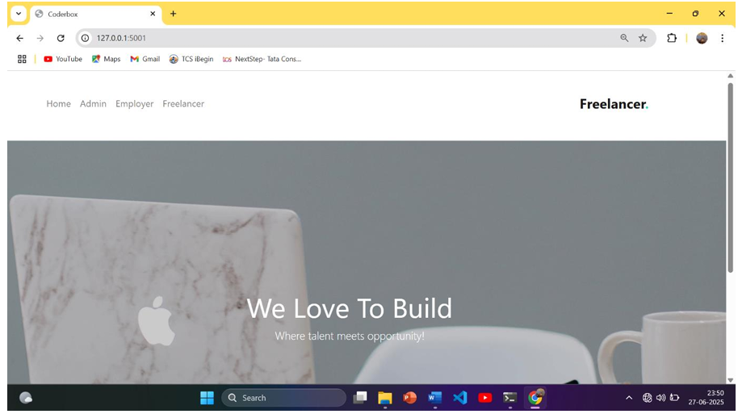
HOME PAGE

Slide 43
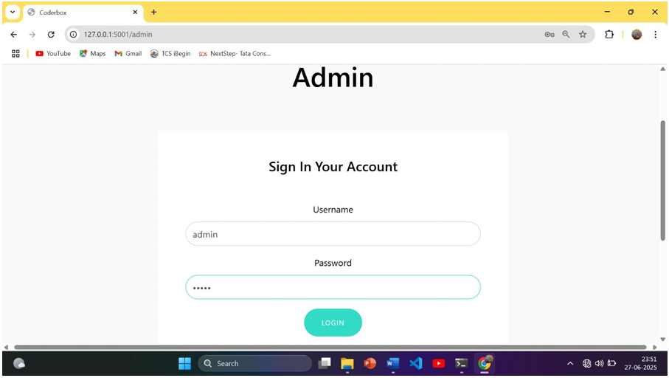
ADMIN LOGIN PAGE

Slide 44
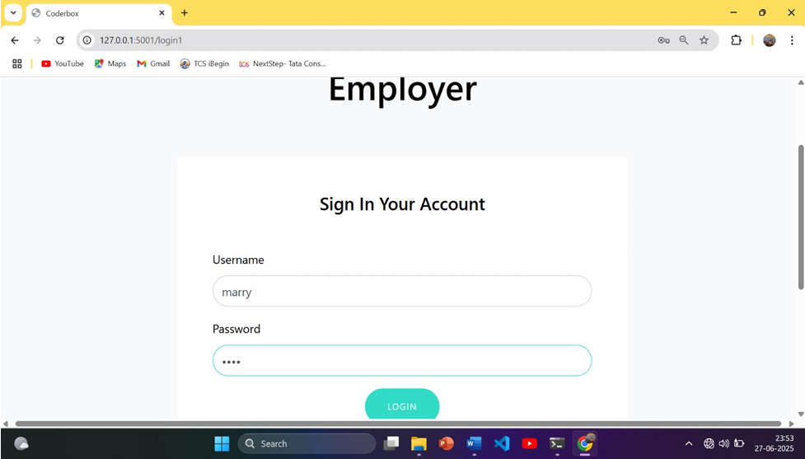
EMPLOYER LOGIN PAGE

Slide 45
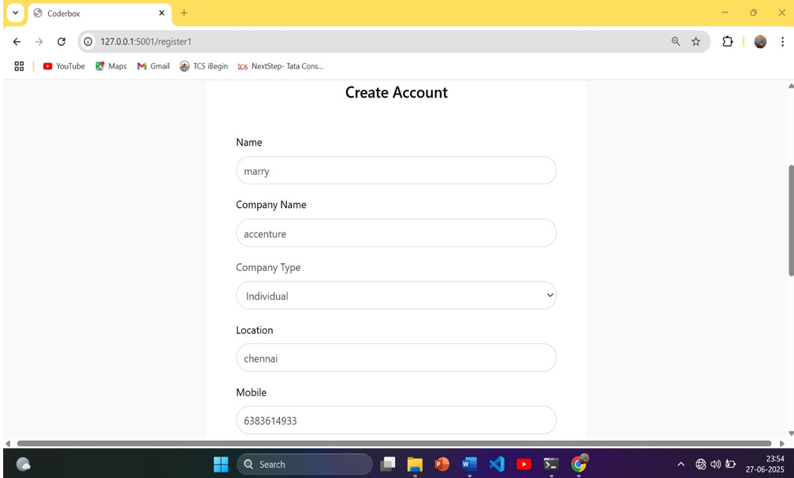
EMPLOYER SIGNUP PAGE

Slide 46
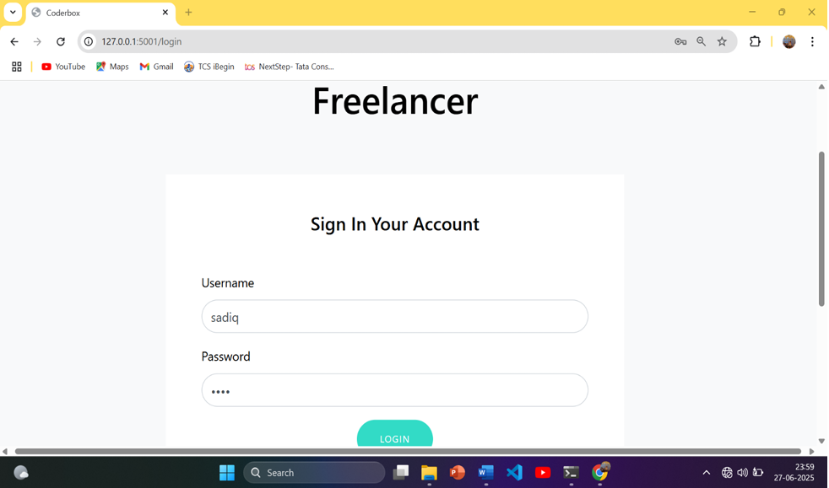
FREELANCER LOGIN PAGE

Slide 47
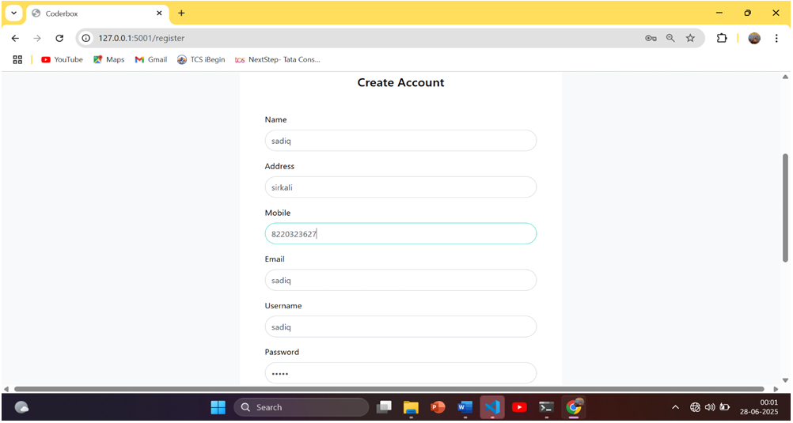
FREELANCER SIGNUP PAGE

Slide 48
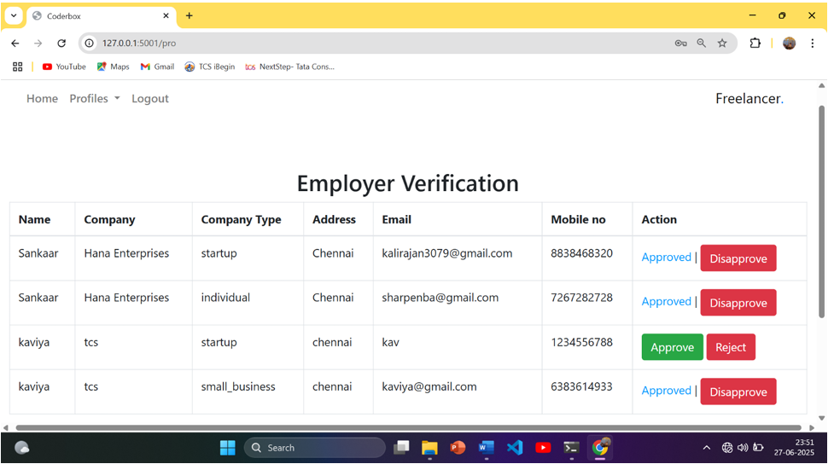
EMPLOYER VERIFICATION

Slide 49
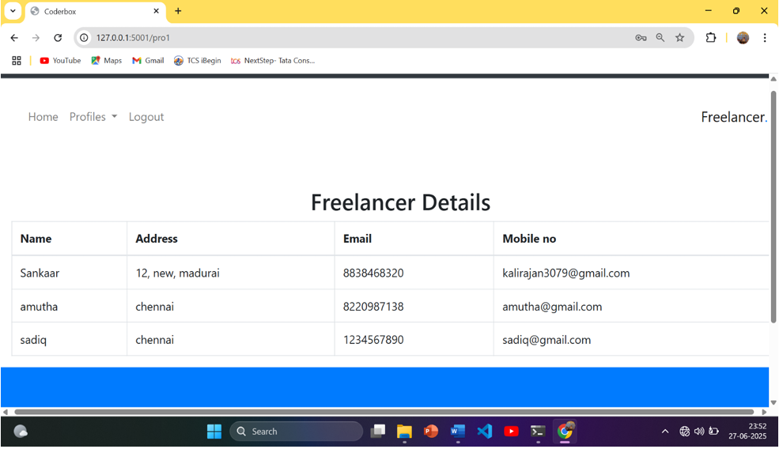
FREELANCER DETAILS

Slide 50
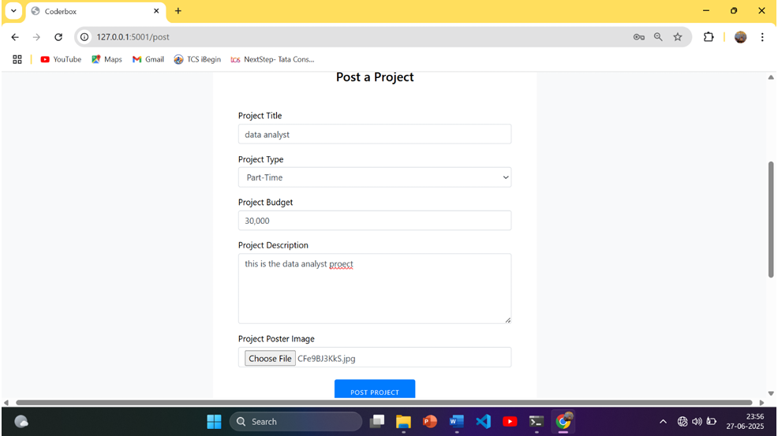
POST A PROJECT

Slide 51
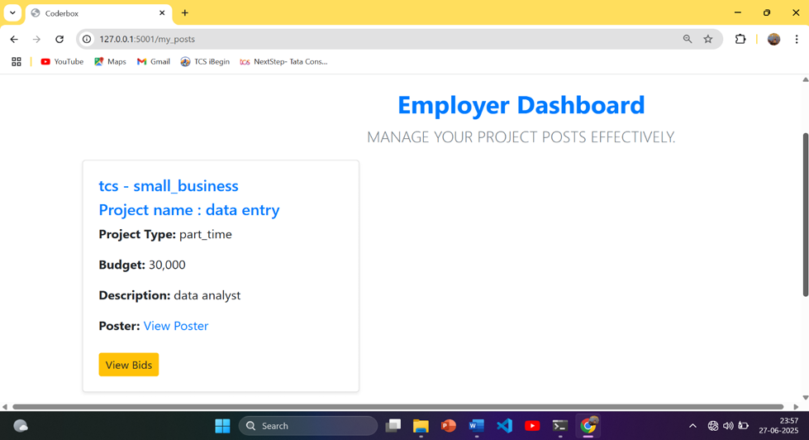
EMPLOYER DASHBOARD

Slide 52
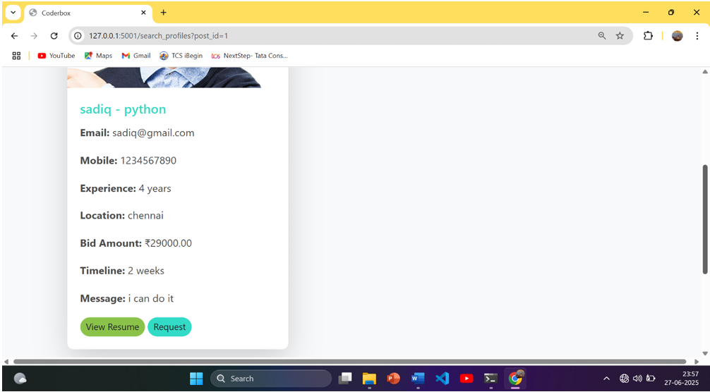
PROJECT BIDS

Slide 53
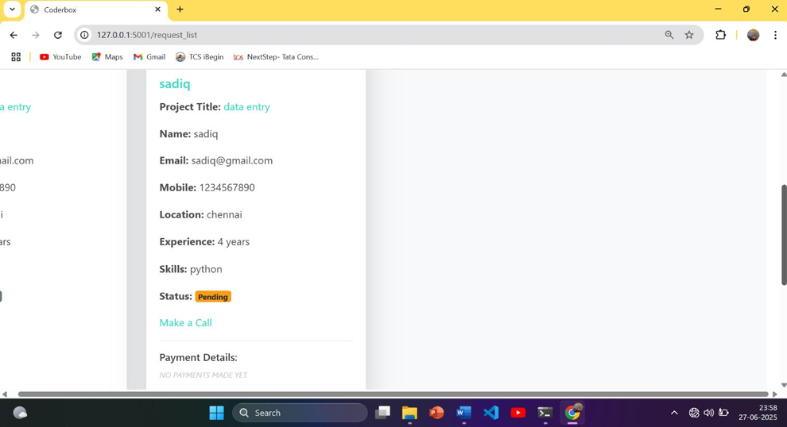
EMPLOYER PROJECT REQUEST

Slide 54
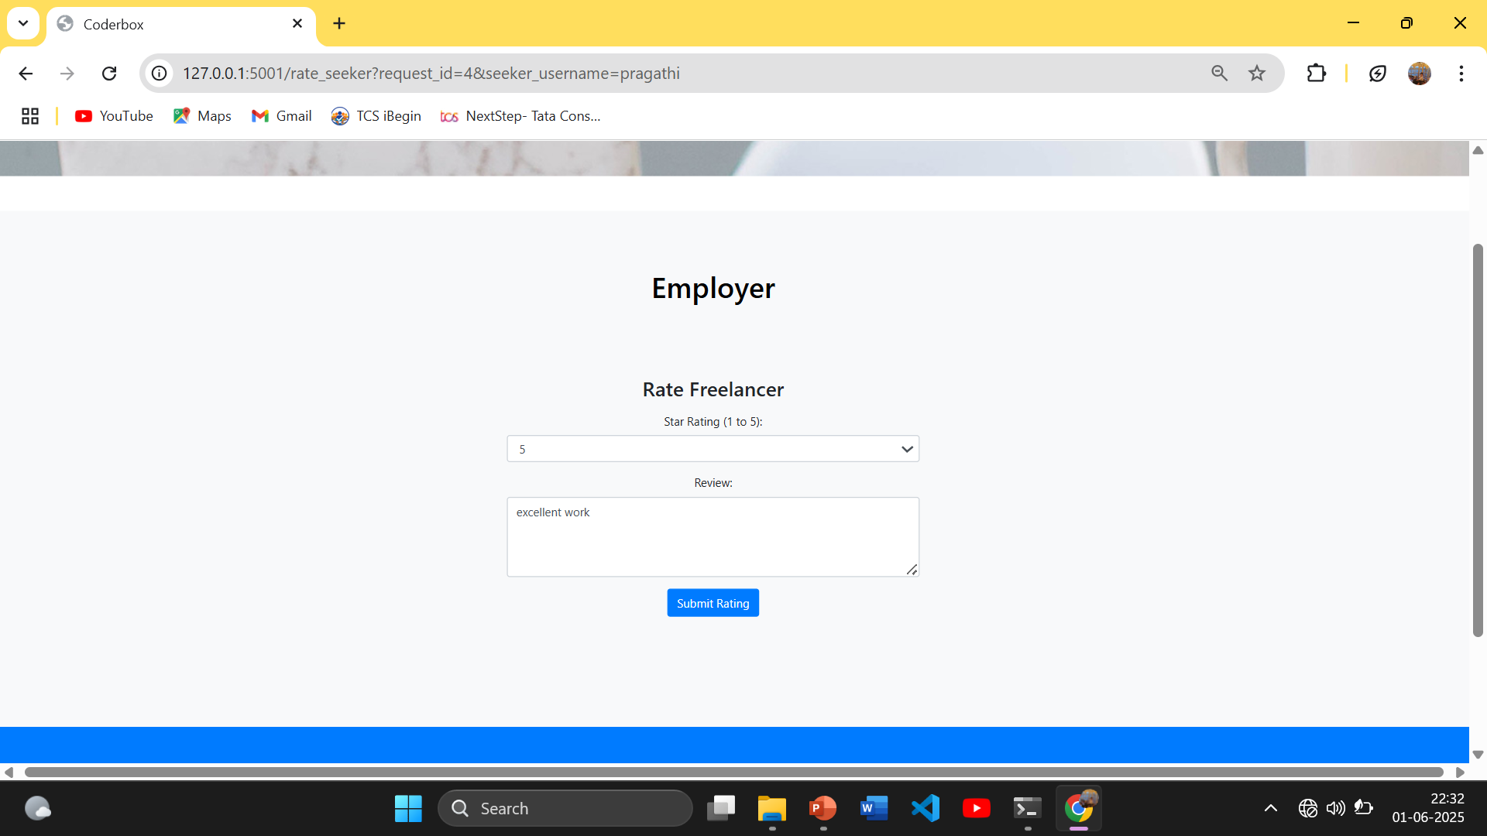
EMPLOYER FEEDBACK

Slide 55
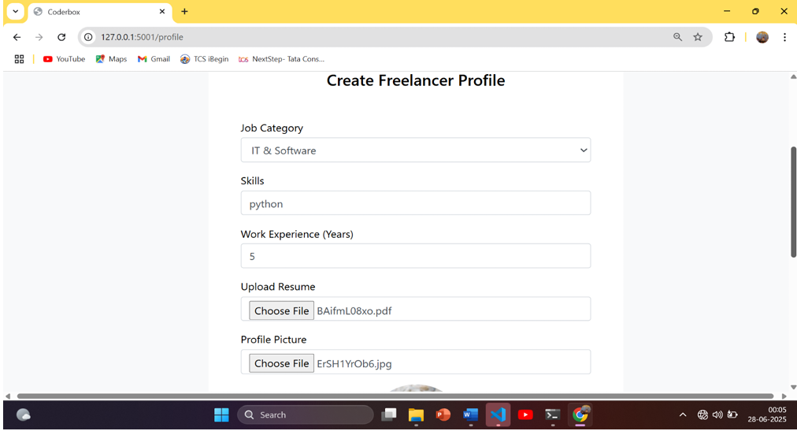
FREELANCER PROJECT

Slide 56
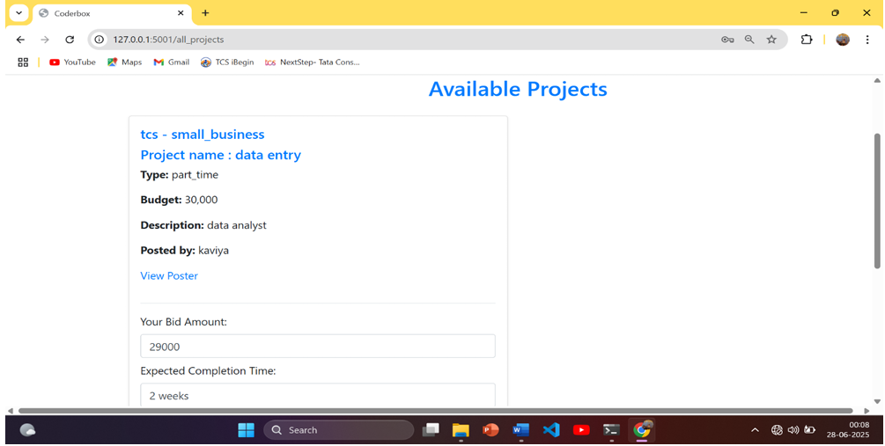
AVAILABLE PROJECTS

Slide 57
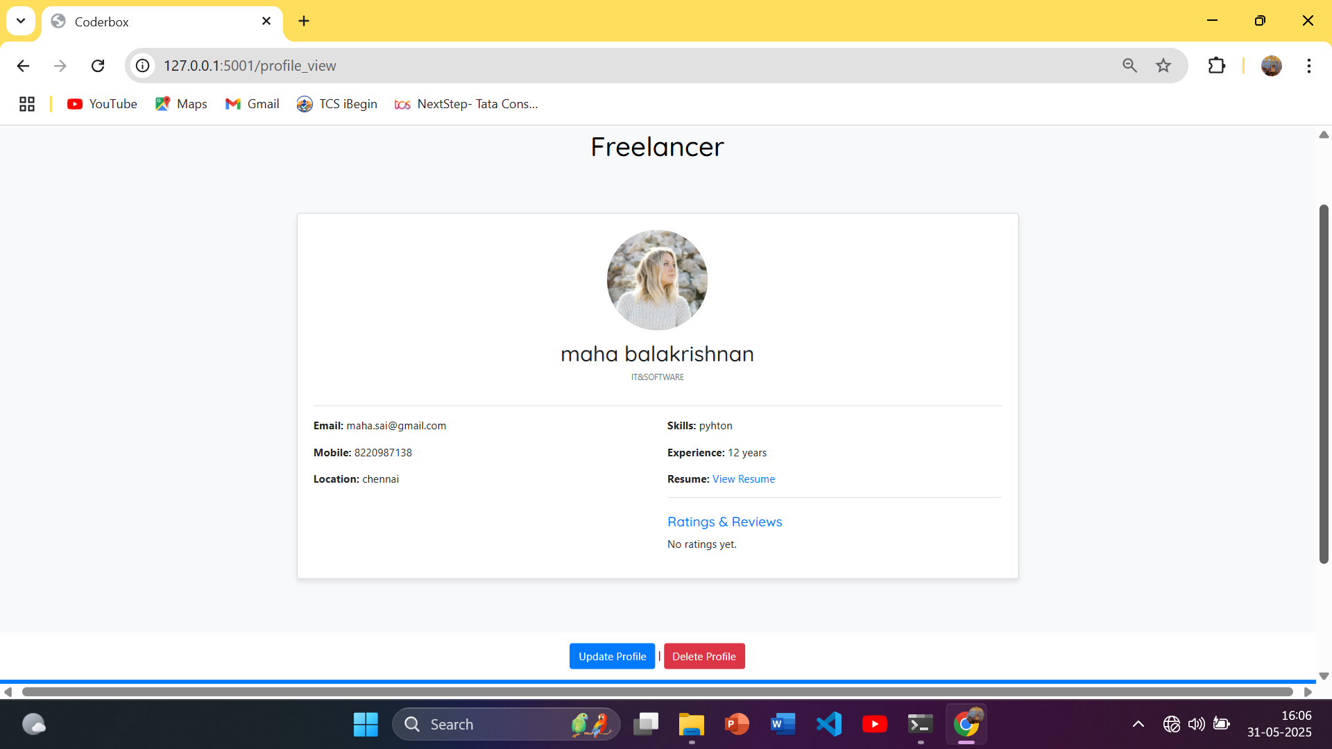
VIEW PROFILE

Slide 58
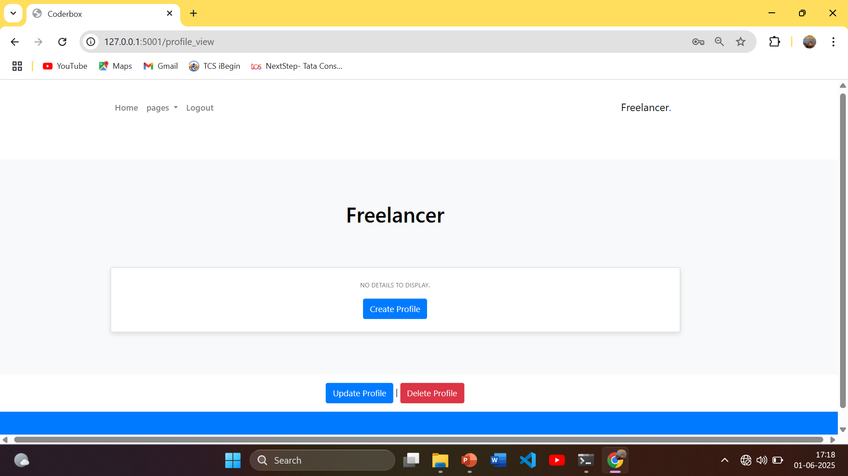
PROFILE DELETION

Slide 59
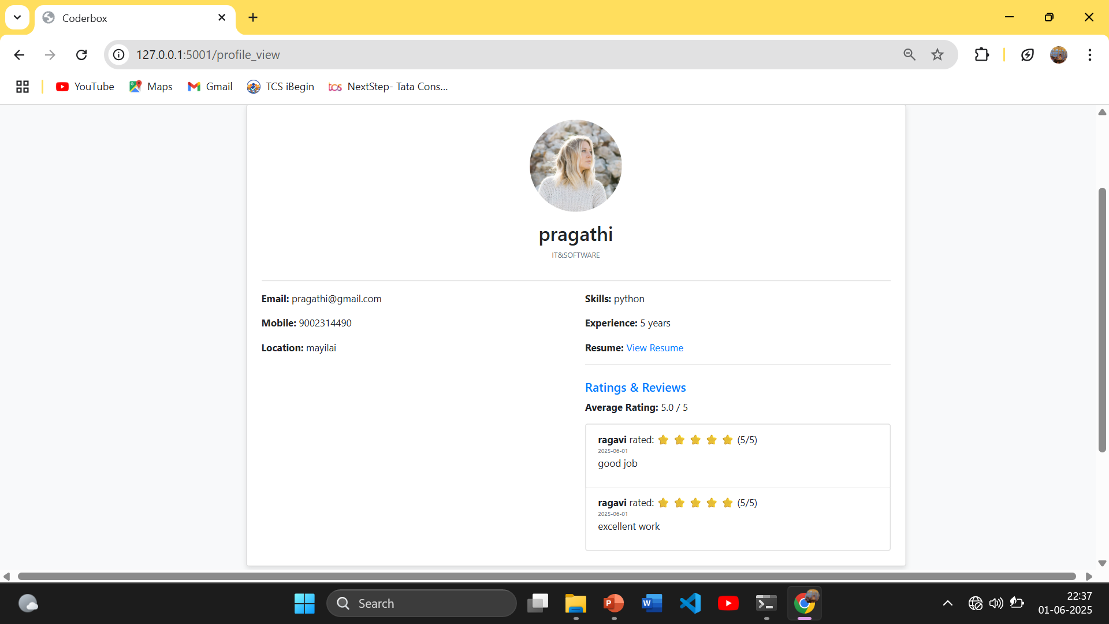
PROFILE DELETION

Slide 60
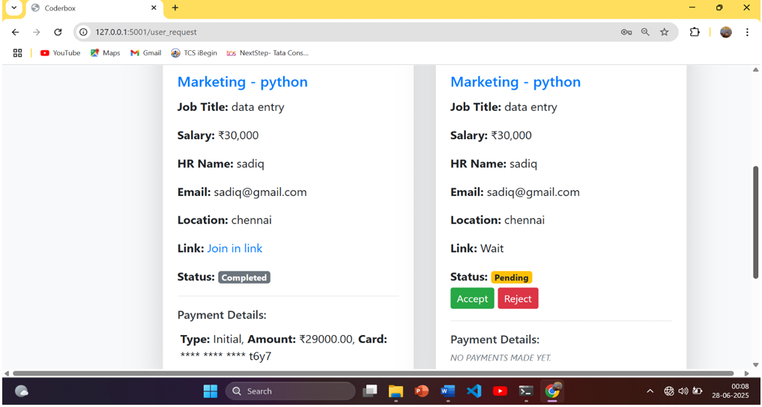
FREELANCER PROJECT REQUEST

Slide 61
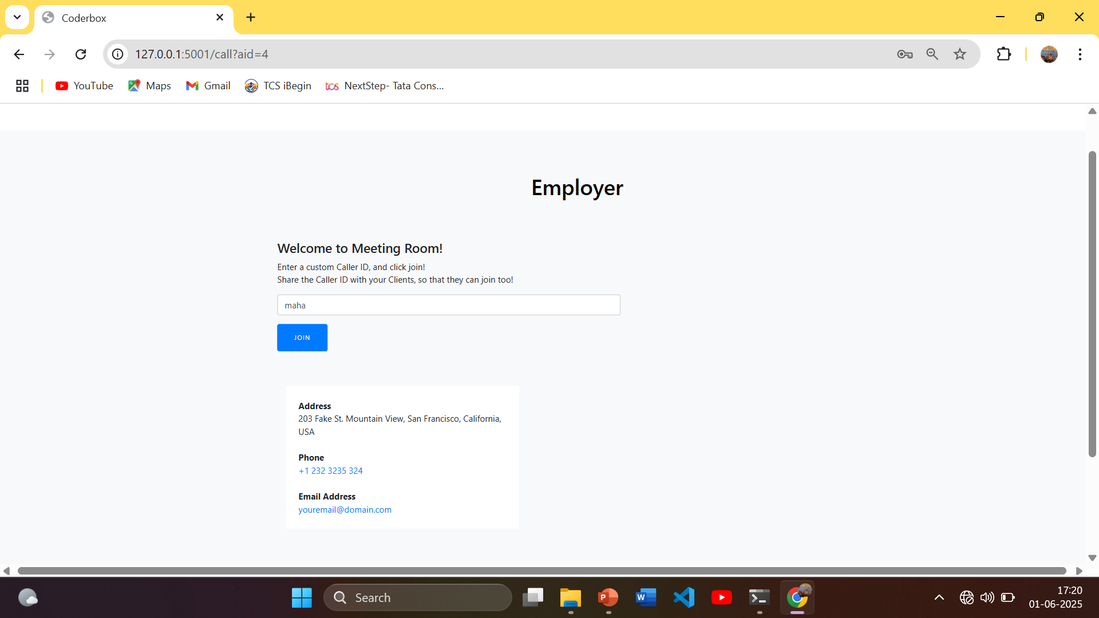
MEETING ROOM PAGE

Slide 62
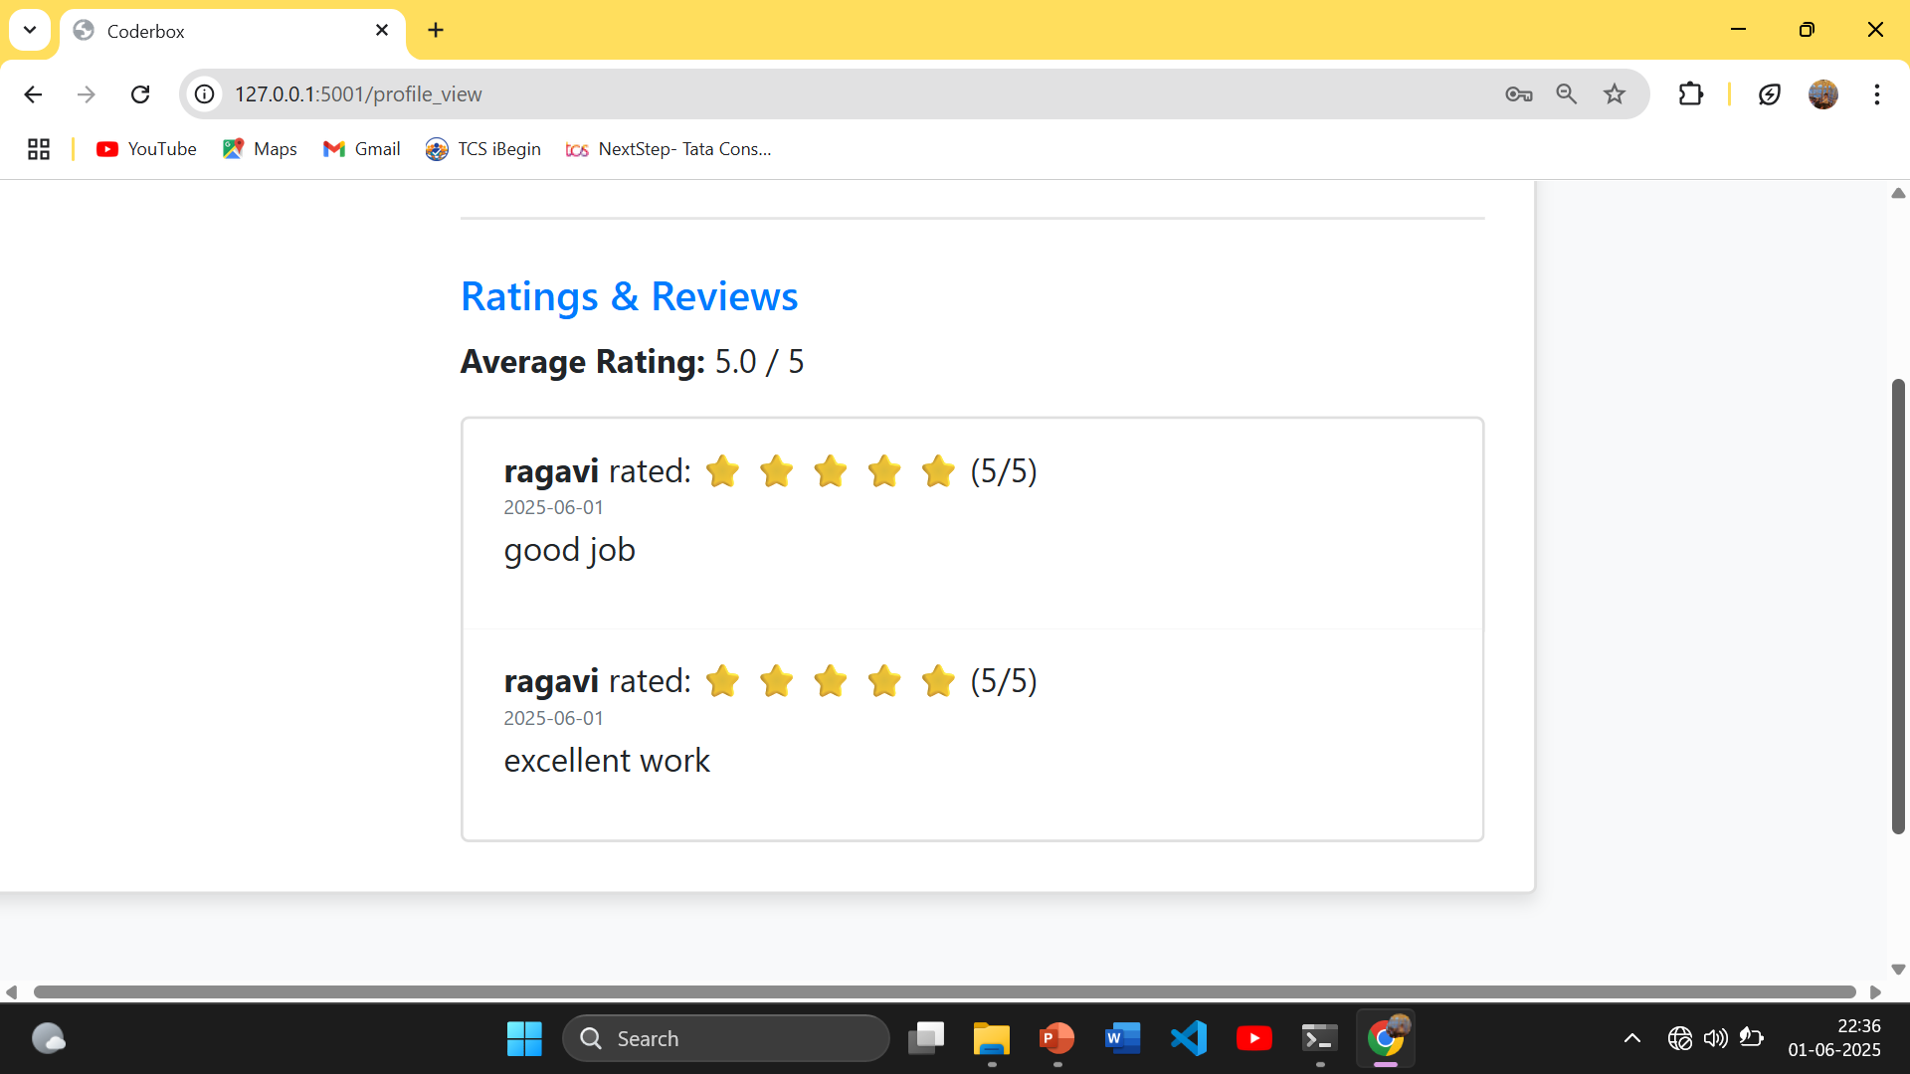
FREELANCER FEEDBACK

Slide 63
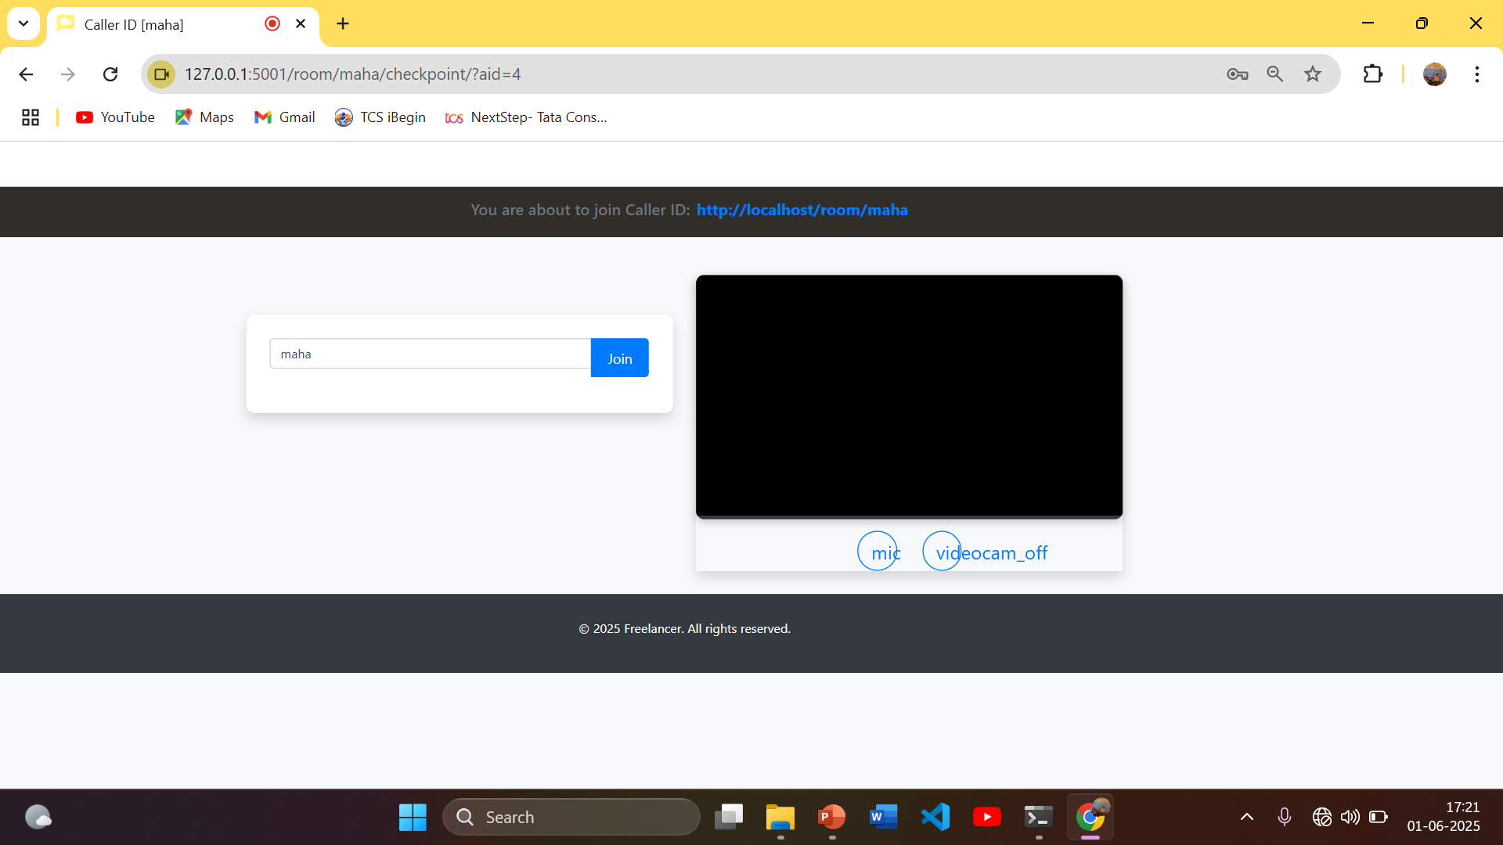
VIDEO CONFERENCE PAGE

Slide 64
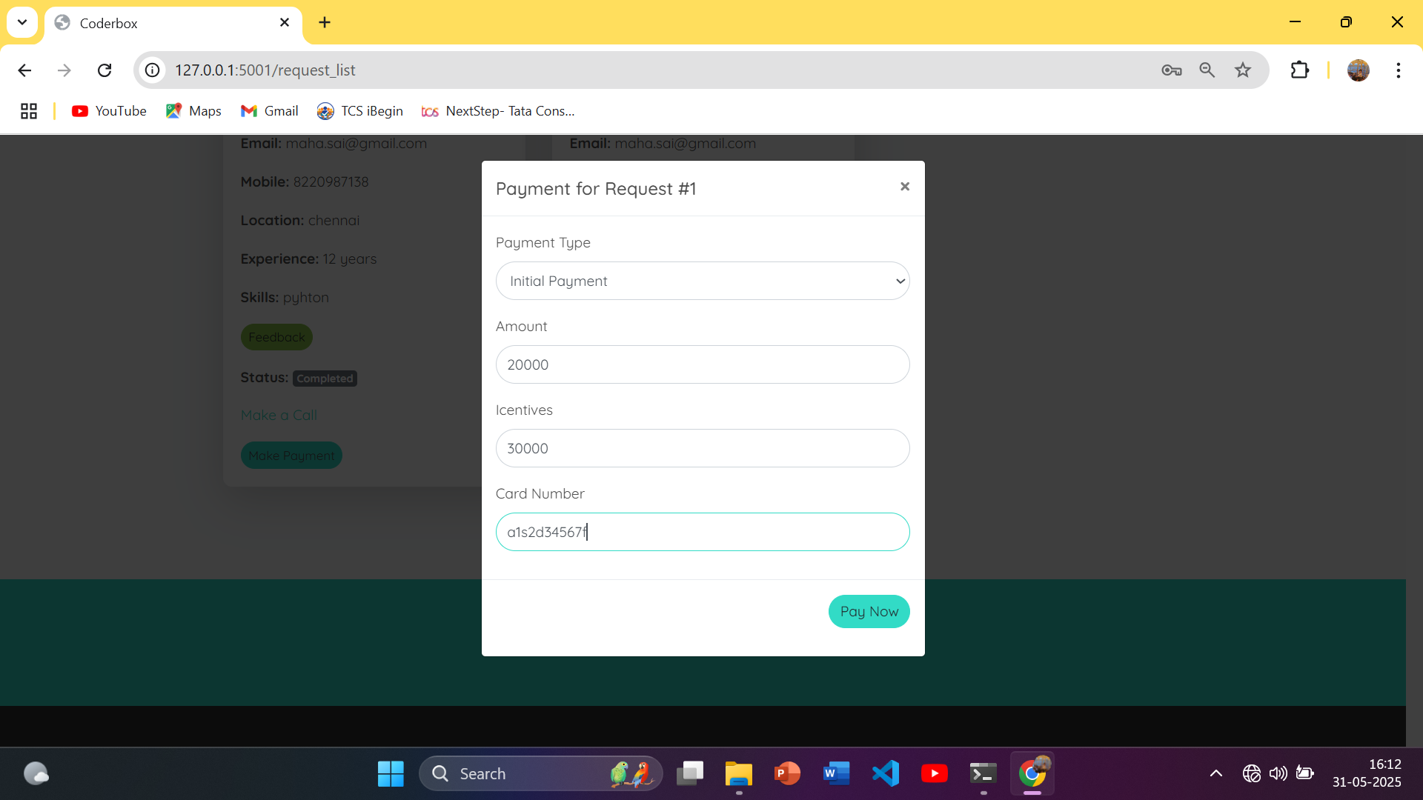
INCENTIVES PAGE

Slide 65
REPORT PAGE

Slide 66
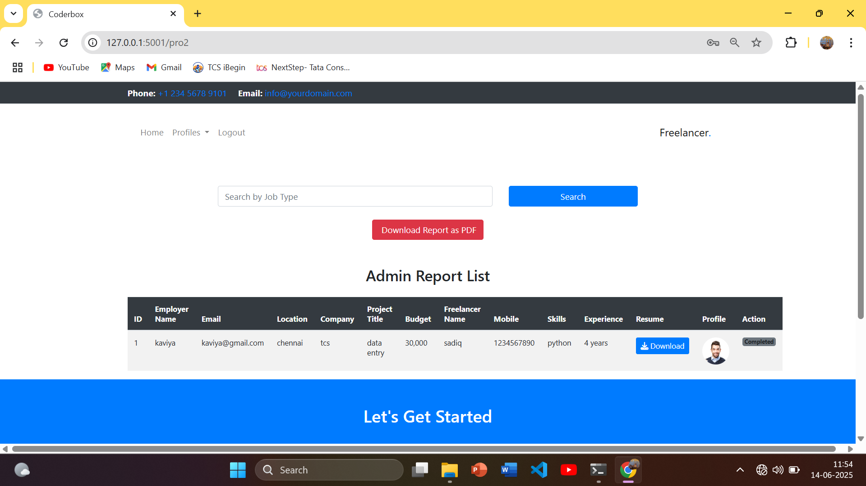
REPORT
Admin wise report:

Slide 67
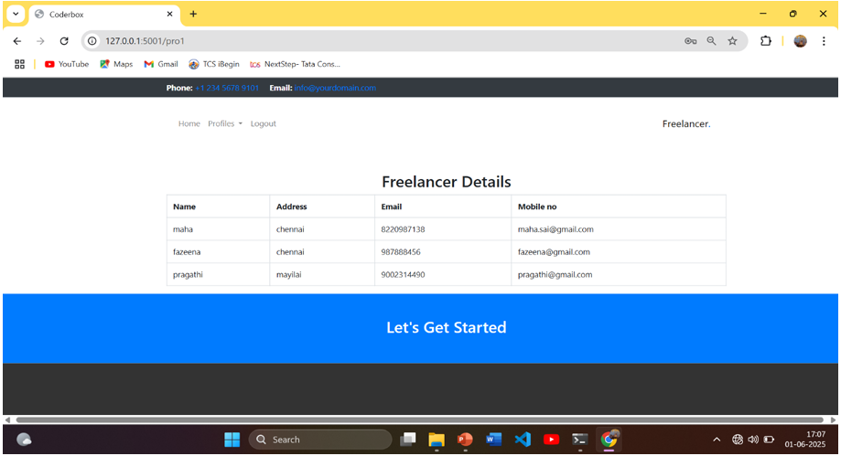
Freelancer wise report:

Slide 68
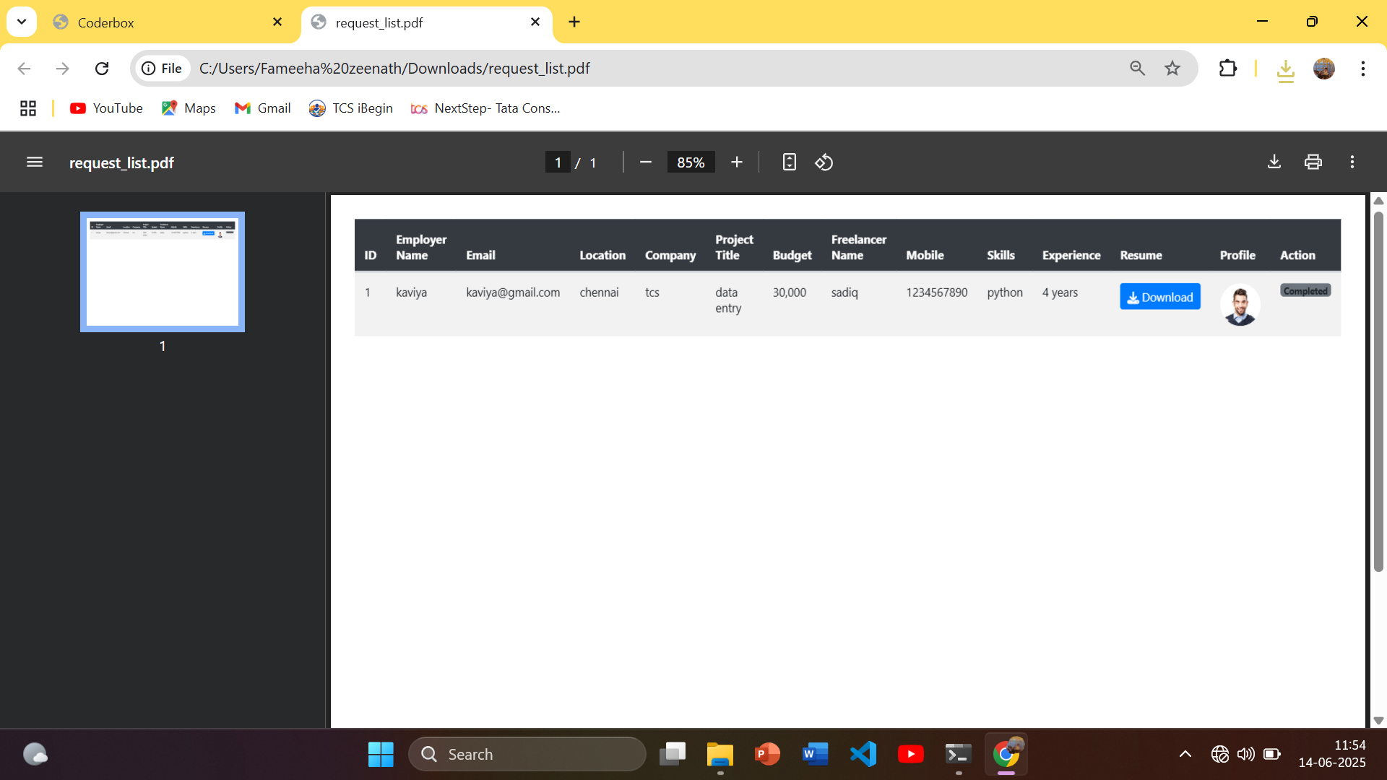
Employer wise report:

Slide 69
SOURCE CODE

Slide 70
SAMPLE SOURCE CODE
from flask import Flask, render_template, request, Response, session, flash, redirect, url_for
from werkzeug.utils import secure_filename
import os
import win32com.client
import pythoncom
import cv2
import string
import random
import numpy as np
import time
import datetime
import mysql.connector
import math
from flask_socketio import SocketIO, emit, join_room, leave_room

Slide 71
app = Flask(__name__)
app.secret_key = "abcdef"
app.config['UPLOAD_FOLDER'] = 'static/resume' # Folder to store songs
socketio = SocketIO(app, async_mode='eventlet') # Explicitly set async_mode
_users_in_room = {} # stores room wise user list
_room_of_sid = {} # stores room joined by an used
_name_of_sid = {} # stores display name of users
app.config['UPLOAD_FOLDER1'] = 'static/profile'
app.config['UPLOAD_FOLDER3'] = 'static/poster'# Folder to store songs
def allowed_file(filename):
ALLOWED_EXTENSIONS = {'pdf', 'docx', 'jpg', 'png'}
return '.' in filename and filename.rsplit('.', 1)[1].lower() in ALLOWED_EXTENSIONS
mydb = mysql.connector.connect(
host="localhost",
user="root",
password="",
charset="utf8",
database="coderbox_bid"
)

Slide 72
@app.route('/rate_seeker')
def rate_seeker():
request_id = request.args.get('request_id')
seeker_username = request.args.get('seeker_username')
return render_template('rate_seeker.html', request_id=request_id, seeker_username=seeker_username)
@app.route('/profile_view')
def profile_view():
username = session.get('username')
cursor = mydb.cursor()
cursor.execute("SELECT * FROM profile WHERE username=%s", (username,))
data = cursor.fetchone()
# Get average rating
cursor.execute("SELECT AVG(rating) FROM ratings WHERE seeker_username = %s", (username,))
avg_rating = cursor.fetchone()[0]

Slide 73
Get all reviews
cursor.execute("SELECT recruiter_username, rating, review, date_submitted FROM ratings WHERE seeker_username = %s", (username,))
reviews = cursor.fetchall()
cursor.close()
return render_template('profile_view.html', data=data, avg_rating=avg_rating, reviews=reviews)
@app.route('/submit_rating', methods=['POST'])
def submit_rating():
recruiter_username = session.get('username')
request_id = request.args.get('request_id')
seeker_username = request.args.get('seeker_username')
rating = int(request.form['rating'])
review = request.form['review']
date_submitted = datetime.datetime.now().date()

Slide 74
cursor = mydb.cursor()
sql = "INSERT INTO ratings (request_id, recruiter_username, seeker_username, rating, review, date_submitted) VALUES (%s, %s, %s, %s, %s, %s)"
val = (request_id, recruiter_username, seeker_username, rating, review, date_submitted)
cursor.execute(sql, val)
mydb.commit()
cursor.close()
flash("Rating submitted successfully.", "success")
return redirect(url_for('request_list'))
@app.route('/', methods=['POST', 'GET'])
def index():
return render_template('index.html’)
@app.route('/admin', methods=['GET', 'POST'])
def admin():
msg = "" # default empty message
if request.method == 'POST':
username = request.form['username']
password = request.form['password’]
cursor = mydb.cursor()
cursor.execute('SELECT * FROM admin WHERE username = %s AND password = %s', (username, password))
account = cursor.fetchone()

Slide 75
if account:
session['username'] = username
session['user_type'] = 'admin'
msg="success"
msg = "fail" # pass failure message
@app.route('/login',methods=['POST','GET'])
def login():
msg=""
if request.method == 'POST':
username = request.form['username']
password = request.form['password']
cursor = mydb.cursor()
cursor.execute('SELECT * FROM seeker WHERE username = %s AND password = %s', (username, password))
account = cursor.fetchone()
if account:
session['username'] = username
msg="success"
else:
msg="fail“

Slide 76
# Get average rating
cursor.execute("SELECT AVG(rating) FROM ratings WHERE seeker_username = %s", (username,))
avg_rating = cursor.fetchone()[0]
# Get all reviews
cursor.execute("SELECT recruiter_username, rating, review, date_submitted FROM ratings WHERE seeker_username = %s", (username,))
reviews = cursor.fetchall()
cursor.close()
return render_template('profile_view.html', data=data, avg_rating=avg_rating, reviews=reviews)
@app.route('/submit_rating', methods=['POST'])
def submit_rating():
recruiter_username = session.get('username')
request_id = request.args.get('request_id')
seeker_username = request.args.get('seeker_username')
rating = int(request.form['rating'])
review = request.form['review']
date_submitted = datetime.datetime.now().date()

Slide 77
@app.route('/login1',methods=['POST','GET'])
def login1():
msg=""
if request.method == 'POST':
username = request.form['username']
password = request.form['password']
cursor = mydb.cursor()
cursor.execute('SELECT * FROM recruiter WHERE username = %s AND password = %s AND status=1', (username, password))
account = cursor.fetchone()
if account:
session['username'] = username
session['user_type'] = 'user'
msg="success"
else:
msg="fail"
return render_template('login1.html',msg=msg)
@app.route('/register',methods=['POST','GET'])
def register():

Slide 78
@app.route('/all_projects', methods=['GET'])
def all_projects():
cursor = mydb.cursor()
cursor.execute("SELECT * FROM posts")
projects = cursor.fetchall()
cursor.close()
return render_template('all_projects.html', projects=projects)
@app.route('/submit_bid', methods=['POST'])
def submit_bid():
if 'username' not in session:
return redirect(url_for('login'))
seeker_username = session['username']
project_id = request.form['project_id']
bid_amount = request.form['bid_amount']
timeline = request.form['timeline']
message = request.form['message']
date_submitted = datetime.datetime.now().date()
cursor = mydb.cursor()

Slide 79
cursor.execute("SELECT max(id)+1 FROM bids")
maxid = cursor.fetchone()[0] or 1
cursor.execute("""
INSERT INTO bids (id, project_id, seeker_username, bid_amount, timeline, message, date_submitted)
VALUES (%s, %s, %s, %s, %s, %s, %s)
""", (maxid, project_id, seeker_username, bid_amount, timeline, message, date_submitted))
mydb.commit()
cursor.close()
flash("Bid submitted successfully!", "success")
return redirect(url_for('all_projects')’
@app.route('/logout')
def logout():
session.clear()
print("Logged out successfully", 'success')
return redirect(url_for('index'))
if __name__ == '__main__':
app.run(port=5001)

Slide 80
CONCLUSION

Slide 81
In conclusion, web based project bidding system for an IT Organization effectively addresses the complexities of freelance recruitment by offering a comprehensive and user-friendly platform that connects businesses with skilled developers globally. The platform enhances the hiring process through advanced features such as detailed coder profiles, a sophisticated skill-matching algorithm, and a transparent review system.
These features collectively streamline project posting, proposal management, and candidate selection, making it easier for companies to find and hire the right talent. Moreover, web based project bidding system ensures a secure and efficient transaction environment by incorporating robust communication tools, payment processing systems, and contract management features.
This facilitates seamless interactions between businesses and freelancers, ensuring clarity and security throughout the engagement process.

Slide 82
FUTURE ENHANCEMENT

Slide 83
Integrating machine learning algorithms to enhance the skill-matching process can provide more accurate and personalized recommendations, improving the relevance of freelancer matches to project requirements.
Implementing blockchain technology for transaction verification and smart contract management can increase security and transparency, ensuring tamper-proof contracts and payment processing.
Allowing freelancers to present their portfolios through AR can offer a more interactive and engaging way for businesses to evaluate their work, enhancing the decision-making process.
Developing more sophisticated real-time collaboration features, such as integrated video conferencing and collaborative coding environments, can improve communication and project management between freelancers and businesses.

Slide 84
REFERENCES

Slide 85
I. Rauf & M. Petre, "Security Thinking in Online Freelance Software Development," IEEE, 2023. https://doi.org/10.1109/ICSE-SEIS58686.2023.00008
B. Pallam & M. M. Gore, "Boomerang: Blockchain-based Freelance Paradigm on Hyperledger," IEEE, 2019. https://doi.org/10.1109/ICCCNT45670.2019.8944572
C. B. A. Khan & A. Ahsan, "Recommended Configuration Management Practices for Freelance Software Developers," IEEE, 2014. https://doi.org/10.1109/ICSESS.2014.6933524
Python: "Python Crash Course" offers a comprehensive introduction to Python programming.
Flask: "Flask Web Development" provides detailed guidance on building web applications with Flask.
MySQL: "Learning MySQL" is a practical guide to mastering MySQL database management.

Slide 86

Organization Name and Address
Genial Digitech Pvt. Ltd.
Plot no 531, MERRYDALE, F1, Sivaraman Street,
Ram Nagar North Extension,
Madipakam,
Chennai 600 091, Tamilnadu, India.
Website : www.genialdigitech.com
Email : info@genialdigitech.com
Phone : 044 4208 5859

Slide 87
Thank You

